Slide 1
COMP 2230
Week 8 - Wednesday

Slide 2
Last time
Exam 2
Before that:
Equivalence relations
Partial order relations

Slide 3
Questions?

Slide 4
Assignment 4

Slide 5
Logical warmup
Each of 100 baskets contains some number (could be zero) of apples and some number (could also be zero) of bananas
Show that you can collect 51 of those baskets that together contain at least half the apples and at least half the bananas
It's actually possible to extend this to a third fruit and still use only 51 baskets (but the math is more confusing)

Slide 6
Partial Orders

Slide 7
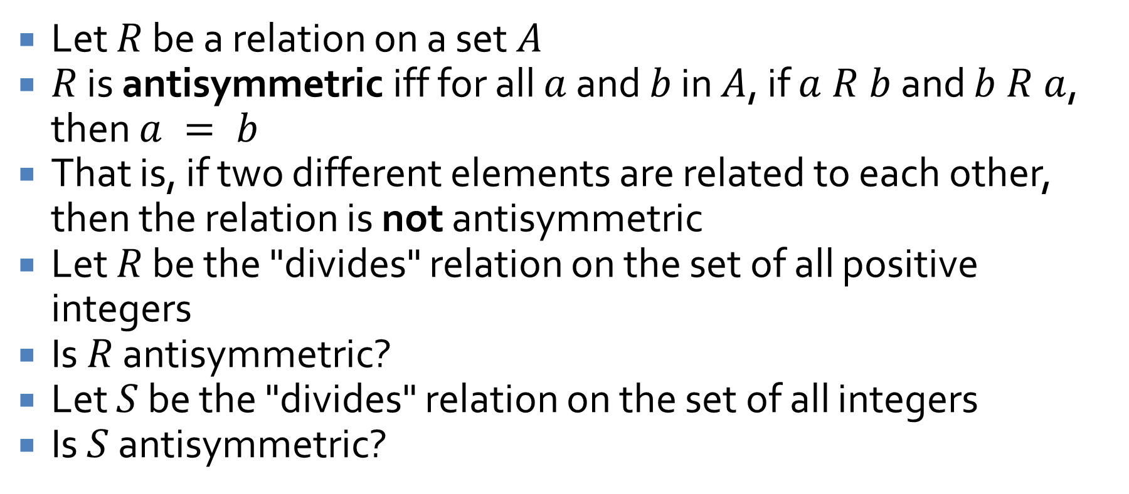
Antisymmetry
Let $R$ be a relation on a set $A$
$R$ is antisymmetric iff for all $a$ and $b$ in $A$, if $a R b$ and $b R a$, then $a = b$
That is, if two different elements are related to each other, then the relation is not antisymmetric
Let $R$ be the "divides" relation on the set of all positive integers
Is $R$ antisymmetric?
Let $S$ be the "divides" relation on the set of all integers
Is $S$ antisymmetric?

Slide 8
Partial orders
A relation that is reflexive, antisymmetric, and transitive is called a partial order
The subset relation is a partial order
Show it's reflexive
Show it's antisymmetric
Show it's transitive
The less than or equal to relation is a partial order
Show it's reflexive
Show it's antisymmetric
Show it's transitive

Slide 9
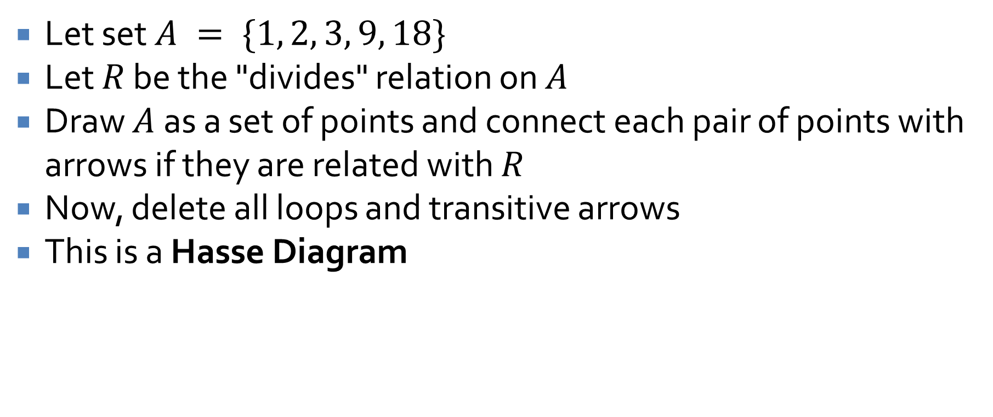
Hasse Diagrams
Let set $A = \{1, 2, 3, 9, 18\}$
Let $R$ be the "divides" relation on $A$
Draw $A$ as a set of points and connect each pair of points with arrows if they are related with $R$
Now, delete all loops and transitive arrows
This is a Hasse Diagram

Slide 10
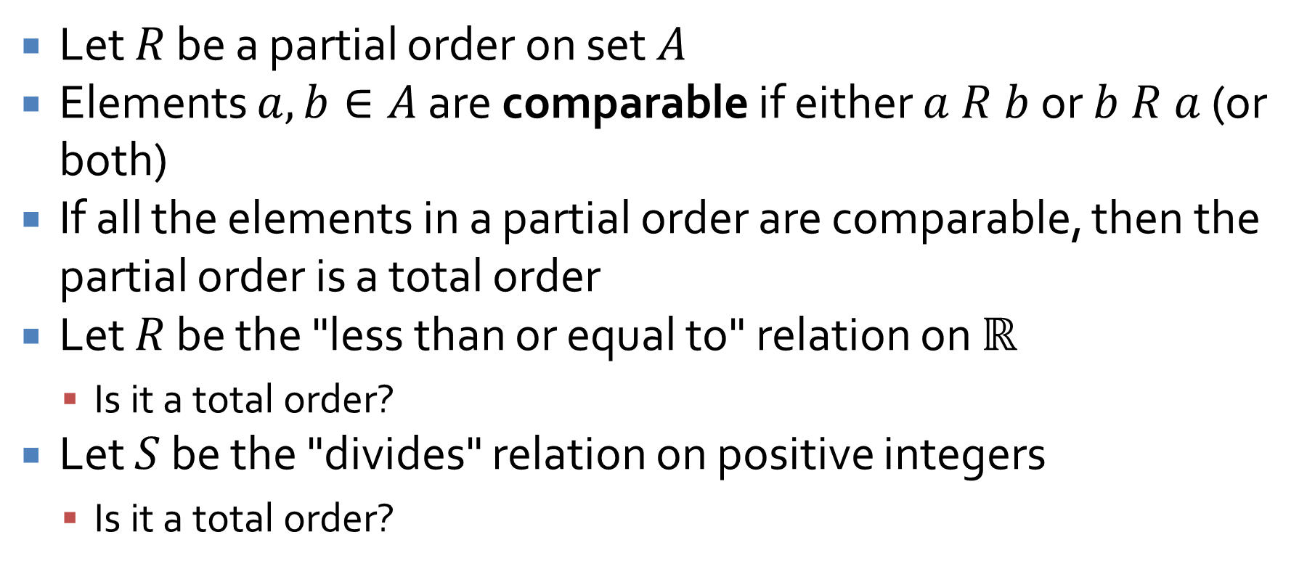
Total orders
Let $R$ be a partial order on set $A$
Elements $a,b∈A$ are comparable if either $a R b$ or $b R a$ (or both)
If all the elements in a partial order are comparable, then the partial order is a total order
Let $R$ be the "less than or equal to" relation on $ℝ$
Is it a total order?
Let $S$ be the "divides" relation on positive integers
Is it a total order?

Slide 11
Probability

Slide 12
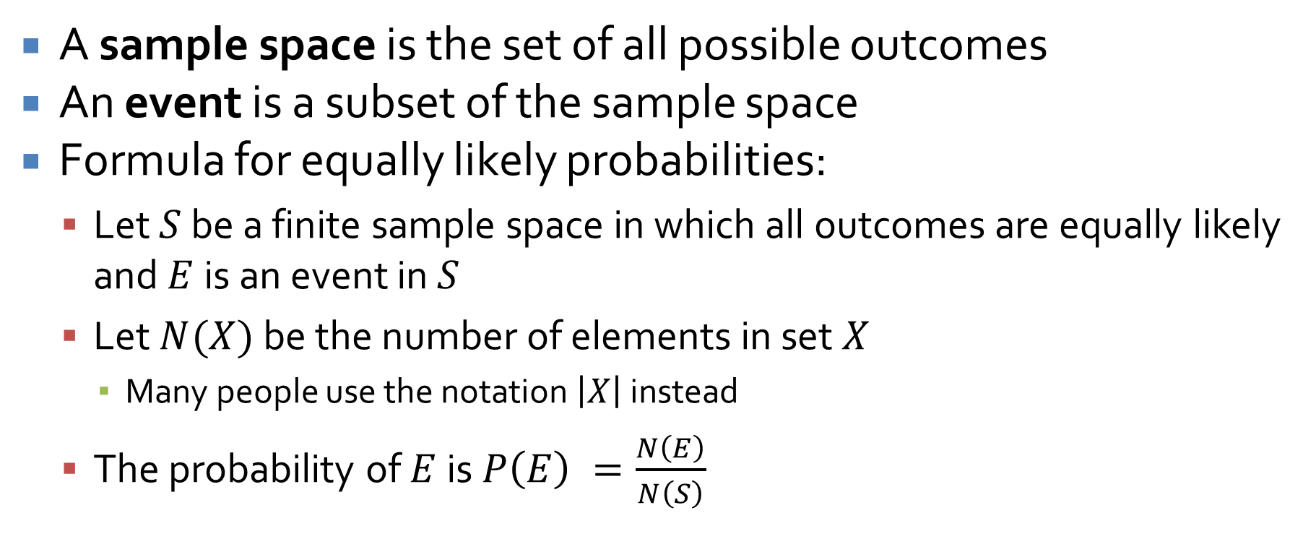
Definitions
A sample space is the set of all possible outcomes
An event is a subset of the sample space
Formula for equally likely probabilities:
Let $S$ be a finite sample space in which all outcomes are equally likely and $E$ is an event in $S$
Let $N(X)$ be the number of elements in set $X$
Many people use the notation $\left|X\right|$ instead
The probability of $E$ is $P\left(E\right) =\frac{N\left(E\right)}{N\left(S\right)}$

Slide 13
Card examples
There are 52 cards in a normal Anglo-American deck of cards
Four suits: Spades, Hearts, Clubs, and Diamonds
13 denominations: Ace, 2, 3, 4, 5, 6, 7, 8, 9, 10, Jack, Queen, King
Imagine you draw a single card from a thoroughly shuffled deck
What is the sample space?
What is the event of drawing a black face card?
What is the probability of drawing a black face card?

Slide 14
Dice example
Six-sided dice have, uh, six sides, numbered 1 through 6
If you roll two dice
What is the sample space of outcomes?
What is the event that the two dice add up to 7?
What is the probability that the two dice add up to 7?
What about all the other possible values?

Slide 15
Monty Hall
Imagine you are playing a game show with 3 doors
There is a prize behind one and nothing behind the other two
As the contestant, you pick a door, but it isn't opened yet
The host Monty Hall opens one of the other two doors, revealing nothing
Then, you get a chance to switch
Should you stay or switch or does it matter?
?
?
?

Slide 16
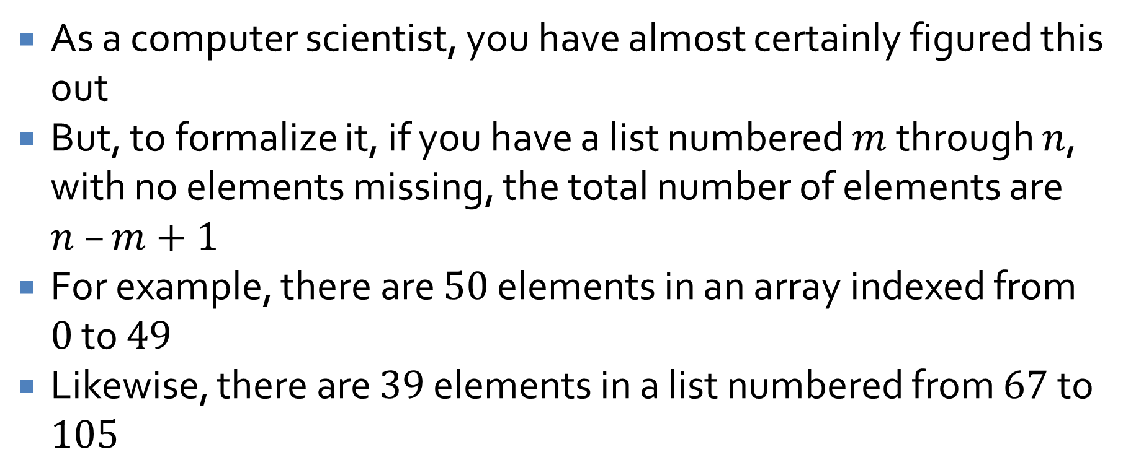
Counting the elements in a list
As a computer scientist, you have almost certainly figured this out
But, to formalize it, if you have a list numbered $m$ through $n$, with no elements missing, the total number of elements are $n –m+1$
For example, there are $50$ elements in an array indexed from $0$ to $49$
Likewise, there are $39$ elements in a list numbered from $67$ to $105$

Slide 17
Ticket Out the Door

Slide 18
Upcoming

Slide 19
Next time…
Multiplication rule
Addition rule
Pigeonhole principle

Slide 20
Reminders
Start Assignment 4
Read 9.2, 9.3, and 9.4

